Slide 1


5th Semester DBMS Mini Project
BRANDWISE MOBILE DATABASE MANAGEMENT SYSTEM
PRESENTED BY:
Saif Ali – 1DB19CS127
Shubham Gupta – 1DB19CS138
GUIDED BY:
Mrs. Shruthi G
Asst. Professor
Department of CSE
DBIT
GUIDED BY:
Dr. Parvathi.C
Assoc. Professor
Department of CSE
DBIT
Department of Computer Science and Engineering
Don Bosco Institute of Technology, Mysore road, Kumbalagodu,Bangalore

Slide 2
AGENDA
INTRODUCTION
ABSTRACT
AIM AND OBJECTIVE
SYSTEM ARCHITECTURE DIAGRAM
TABLE LIST
ER DIAGRAM
SCHEMA DIAGRAM
CONCLUSION
REFERENCE

Slide 3
INTRODUCTION
Banks are a very important part of the economy because they provide vital services for both consumers and businesses. As financial services providers, they give you a safe place to store your cash. Through a variety of account types such as checking and savings accounts and certificates of deposit (CDs)
Banks also provide credit opportunities for people and corporations. The bank lends the money you deposit at the bank—short-term cash—to others for long-term debt such as car loans, credit cards, mortgages, and other debt vehicles. This process helps create liquidity in the market—which creates money and keeps the supply going..

Slide 4
ABSTRACT
We will use technologies like MySQL, HTML, CSS and PHP to build this website which would help us acquire skills of web development.
We want to build a website which could help the bank officials and customers to perform different transactions.
The user has the choice to make his decision based on the requirements according to him/her.
The admin of bank can view customer transactions and add new or remove a customer from bank.

Slide 5
AIM AND OBJECTIVE
Aim:
The main aim and objective were to plan and program system application. We justify to apply the best software engineering practice for system application. We developed a “BANK MANAGEMENT SYSTEM” using HTML & SQL.
Objective:
The Bank Account Management System is a database for maintaining a person’s account in the bank. In this mini project we tried to show the working of bank account system and cover the basic functionality of Bank account management system. This project is developed using PHP and MySQL to build this website which would help us acquire skills of web development. This website helps the customer to maintain his/her account in the bank and helps them to deposit or withdraw money from their account

Slide 6
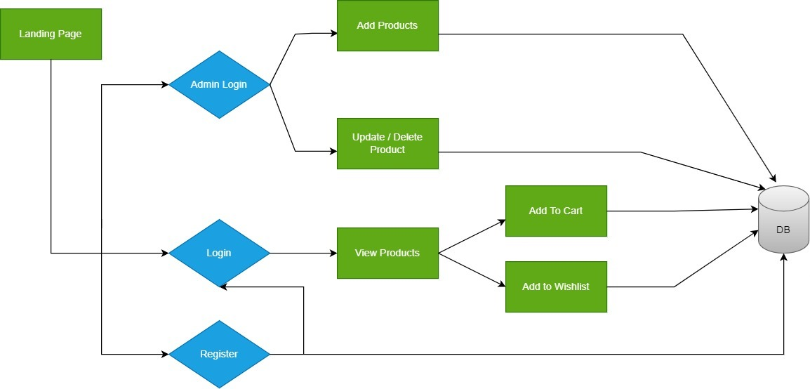
SYSTEM ARCHITECTURE DIAGRAM
Add customer
Update or delete customer
Perform new transactions
View transactions
Add money

Slide 7
TABLE LIST
CREATE TABLE `admin` ( `id` int(11) NOT NULL, `uname` char(25) DEFAULT NULL, `pwd` char(25) DEFAULT NULL) ENGINE=InnoDB DEFAULT CHARSET=latin1;
CREATE TABLE `beneficiary1` ( `benef_id` int(11) NOT NULL, `benef_cust_id` int(11) DEFAULT NULL, `email` varchar(30) DEFAULT NULL, `phone_no` varchar(20) DEFAULT NULL, `account_no` int(11) DEFAULT NULL)
CREATE TABLE `beneficiary2` ( `benef_id` int(11) NOT NULL, `benef_cust_id` int(11) DEFAULT NULL, `email` varchar(30) DEFAULT NULL, `phone_no` varchar(20) DEFAULT NULL, `account_no` int(11) DEFAULT NULL) ENGINE=InnoDB DEFAULT CHARSET=latin1;

Slide 8
CREATE TABLE `customer` ( `cust_id` int(11) NOT NULL, `first_name` varchar(30) DEFAULT NULL, `last_name` varchar(30) DEFAULT NULL, `gender` varchar(10) DEFAULT NULL, `dob` date DEFAULT NULL, `aadhar_no` int(11) DEFAULT NULL, `email` varchar(30) DEFAULT NULL, `phone_no` varchar(20) DEFAULT NULL, `address` varchar(255) DEFAULT NULL, `branch` varchar(30) DEFAULT NULL, `account_no` int(11) DEFAULT NULL, `pin` int(4) DEFAULT NULL, `uname` varchar(30) DEFAULT NULL, `pwd` varchar(30) DEFAULT NULL)
CREATE TABLE `news` ( `id` int(10) UNSIGNED NOT NULL, `title` varchar(40) DEFAULT NULL, `created` datetime DEFAULT NULL)

Slide 9
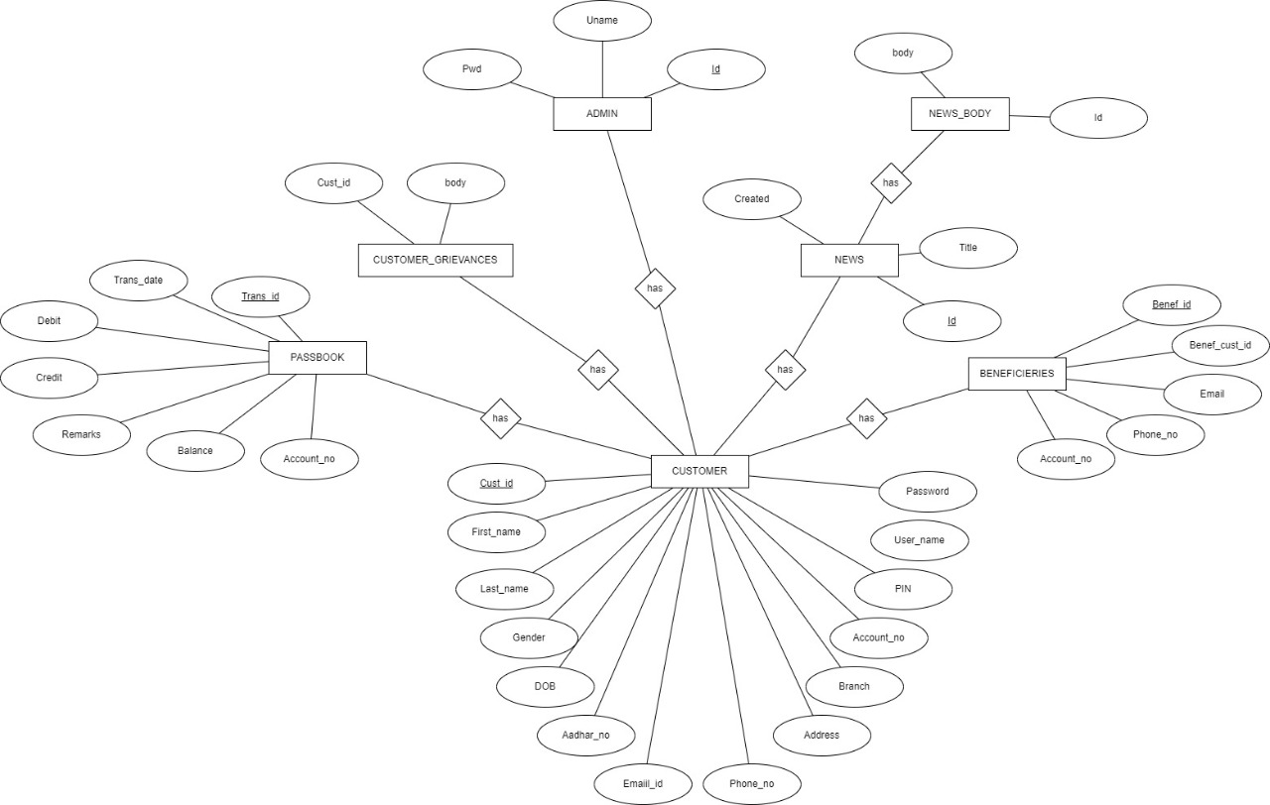
ER DIAGRAM

Slide 10
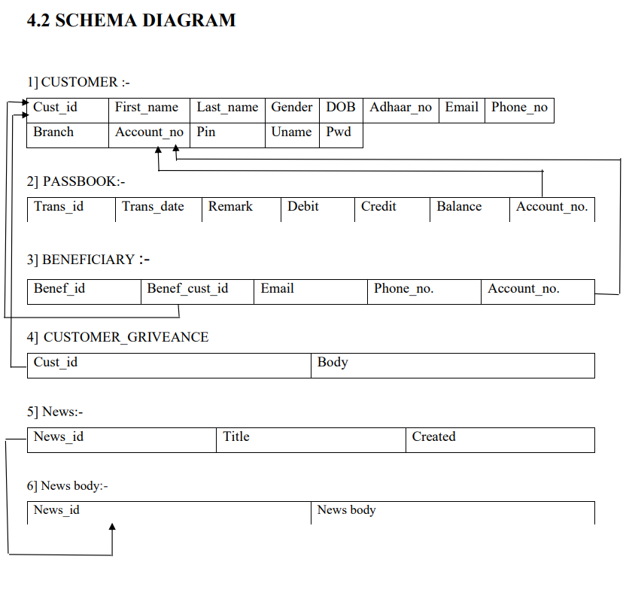

Slide 11
CONCLUSION
Thus we have successfully implemented “Bank Management System” which helps us in centralizing the data used for managing the tasks performed in a banking. We have successfully implemented various functionalities of HTML/CSS/JS/PHP/MySQL and python and created the fully functional database management system for bank.

Slide 12
REFERENCES
1. Ramez Elmasri, Shamikant B. Navathe; Fundamentals of Database Management Systems; 5th Edition; Pearson; 2017
2. Raghuramakrishnan, and Gehrke; Database Management Systems; 3rd edition; McGraw Hill; 2014
3. https://www.w3schools.com/sql/default.asp
4. https://www.w3schools.com/php/default.asp
5. https://getbootstrap.com/docs/5.1/getting-started/introduction/
6. https://www.youtube.com/c/CodeWithHarry/
7. https://www.w3schools.com/css/default.asp

Slide 13
Thank You

